Slide 1
EVENT SHOWCASE WEBSITE

Slide 2
TEAM MEMBERS
NITESH KUMAR SHARMA (201500450)
NIKHIL CHAUDHARY (2015438)
KRATIKA RATHORE (201500347
MANYA JAIN (201500391)

Slide 3
OUTLINE
INTRODUCTION
ABOUT PROJECT
TECHNOLOGIES USED
WORKING
OUR WEBSITE

Slide 4
INTRODUCTION
The purpose of this project is to showcase the various events that have
taken place in your university. Universities are often bustling with a
diverse range of events, such as guest lectures, cultural festivals,
sports competitions, and academic conferences, among others. These
events not only add to the vibrancy of campus life but also provide
opportunities for students to engage with a wide variety of
intellectual, cultural, and social experiences.

Slide 5
DESCRIPTION
Our university is a hub of activity, with a diverse range of events
happening throughout the year. From guest lectures to cultural
festivals to sports competitions, there is always something happening
on campus. This project aims to showcase the variety of events that
take place at our university, highlighting their impact on the
university community and encouraging others to participate in future
events

Slide 6
TECHNOLOGIOES USED
HTML
CSS
PHP
DATABASE

Slide 7
BENEFITS
All in one event management website
Time saving
Event automation
Increase engagement rate at events

Slide 8
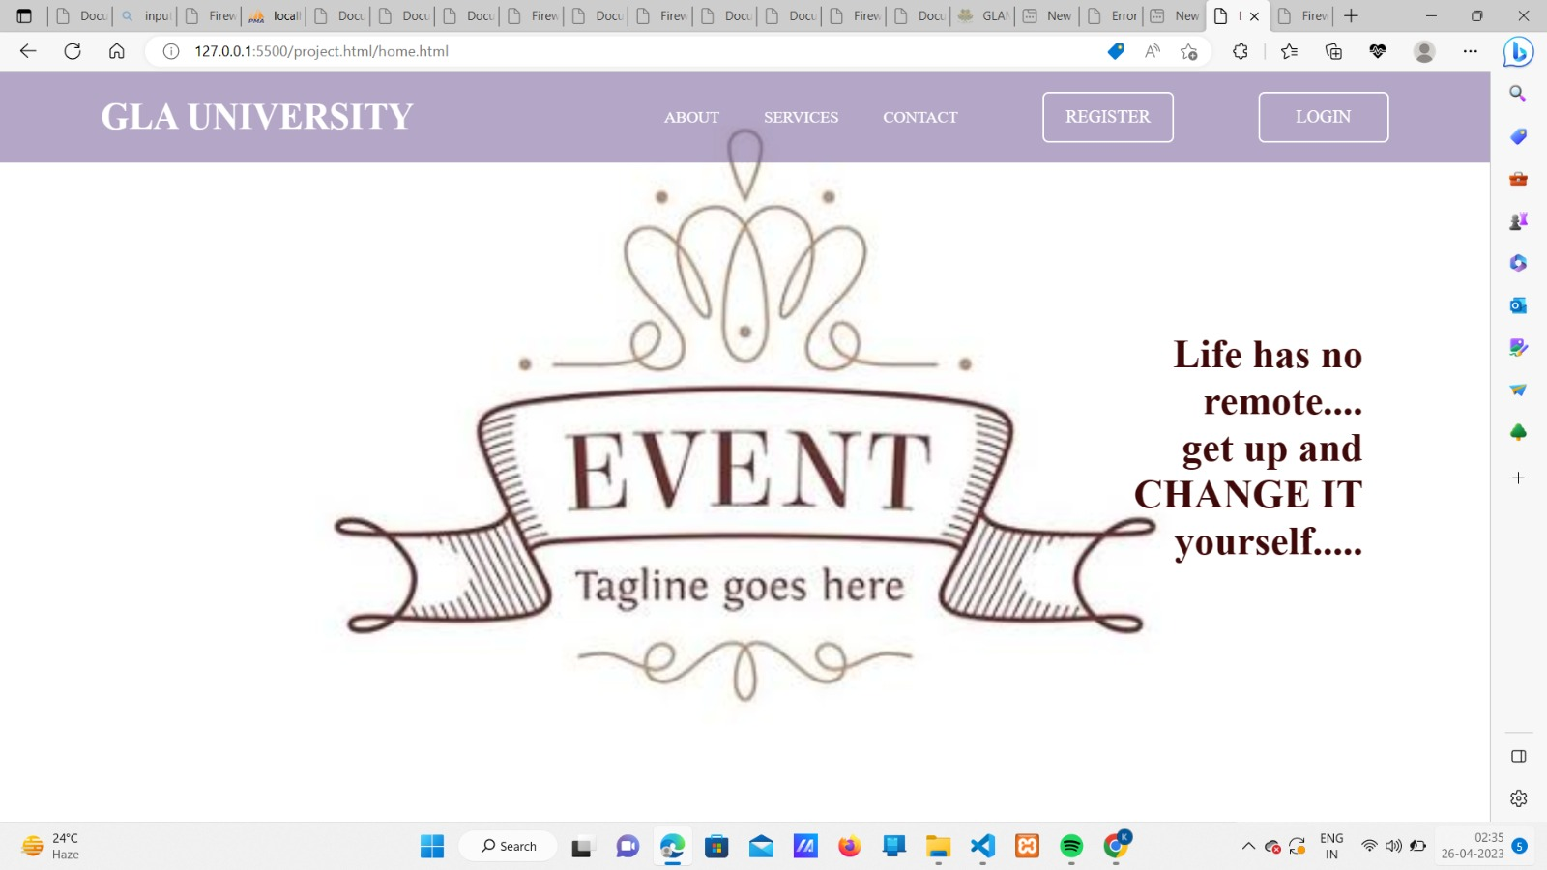
OUR WEBSITE

Slide 9
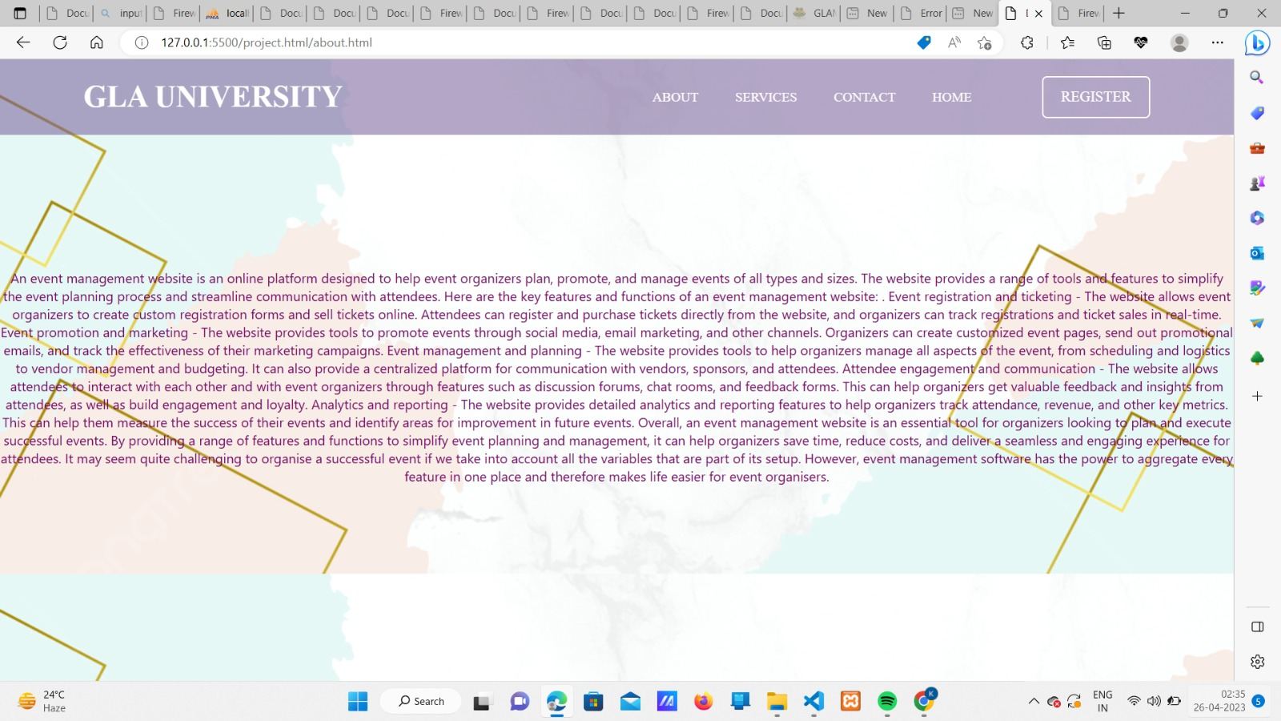

Slide 10
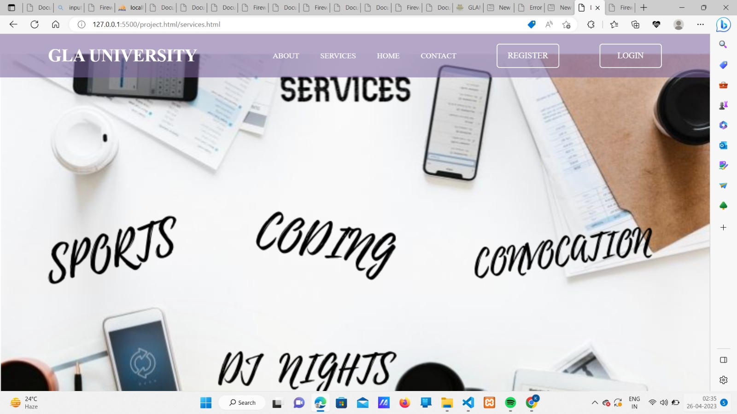

Slide 11
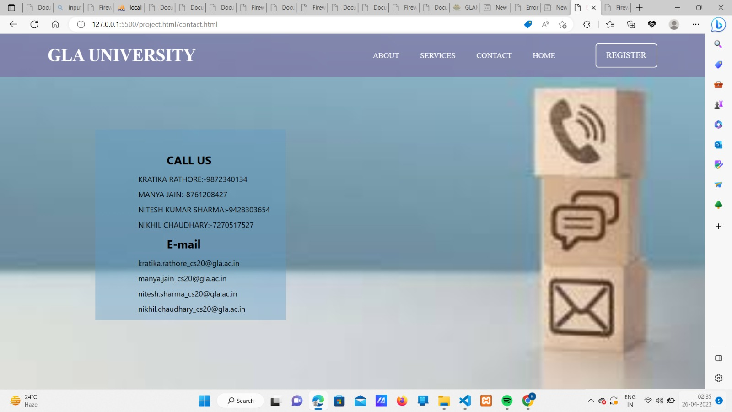

Slide 12
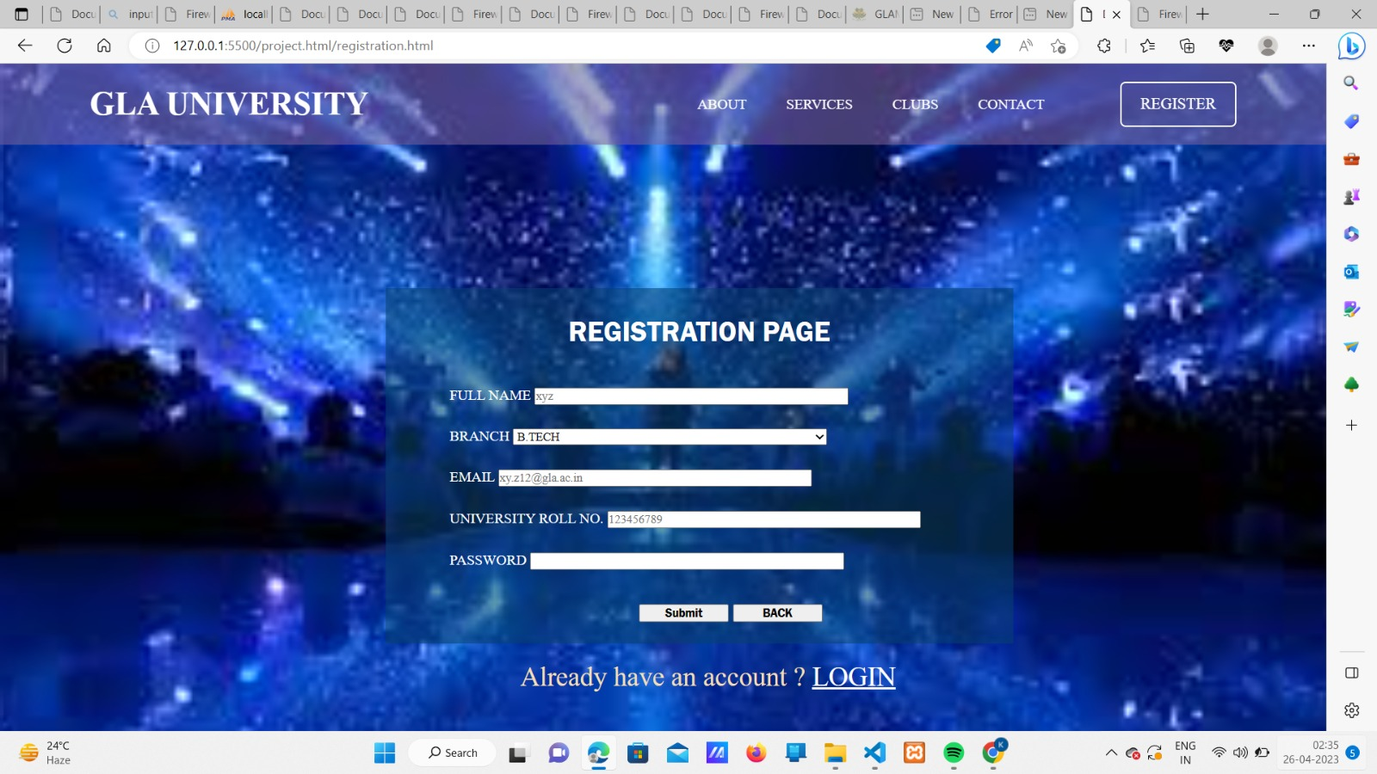

Slide 13
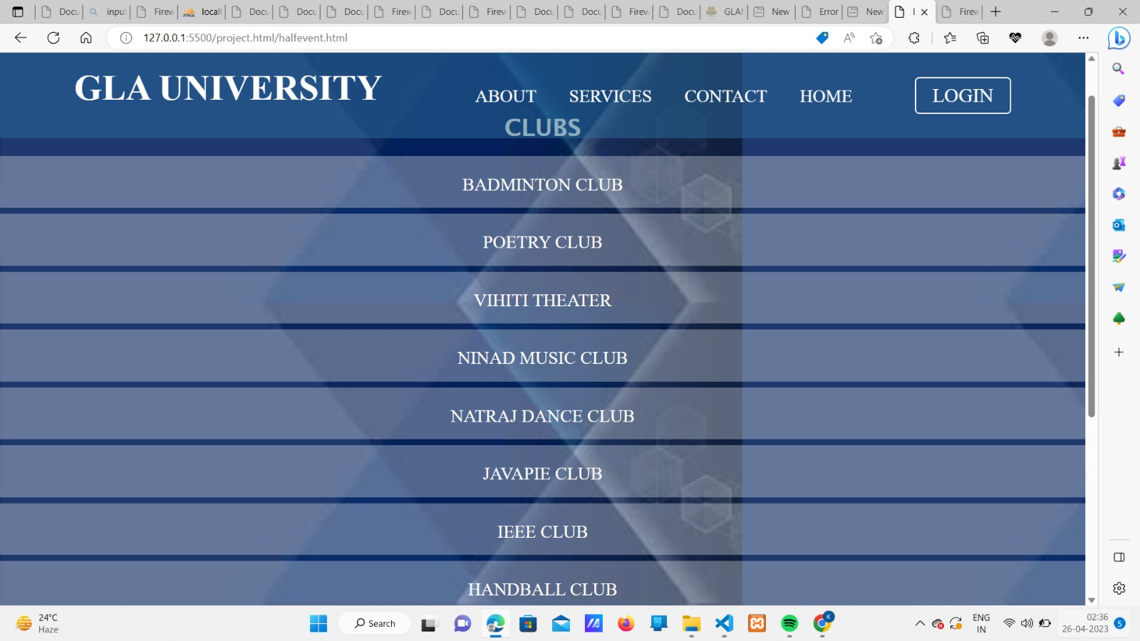

Slide 14
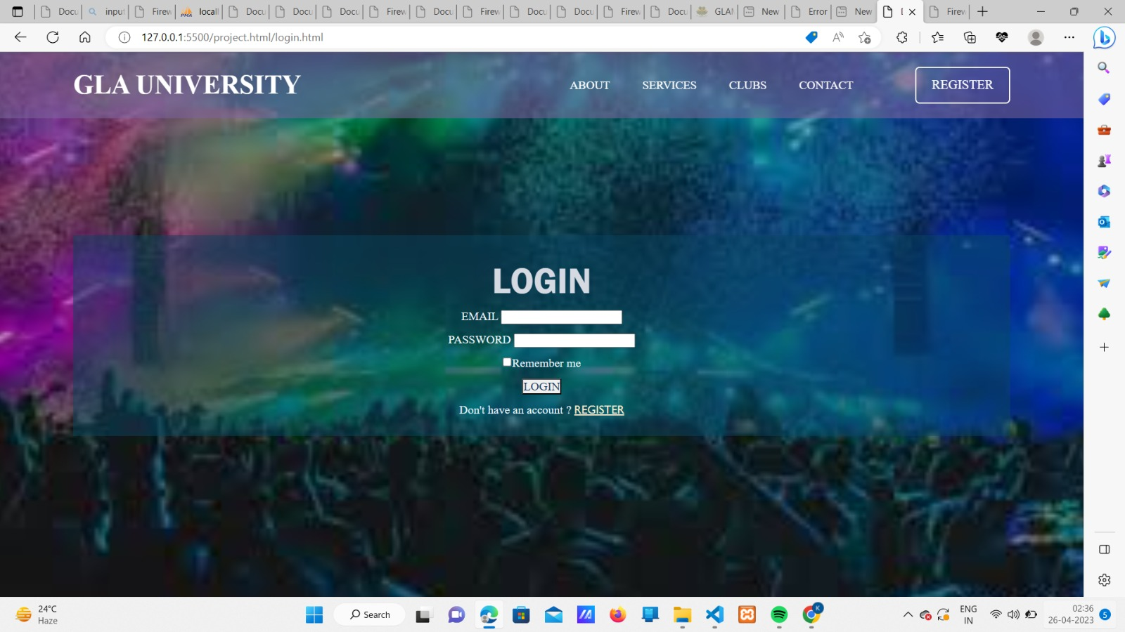

Slide 15
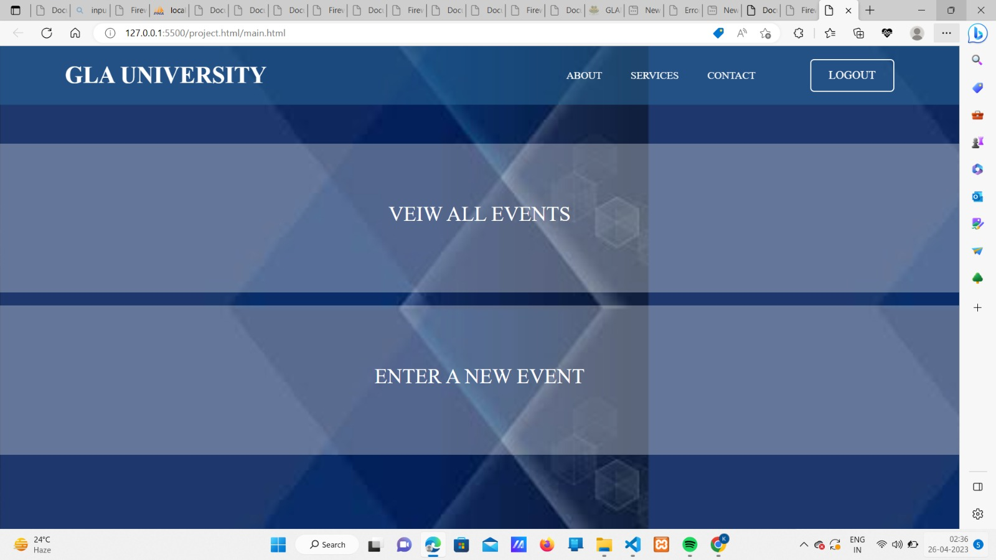

Slide 16
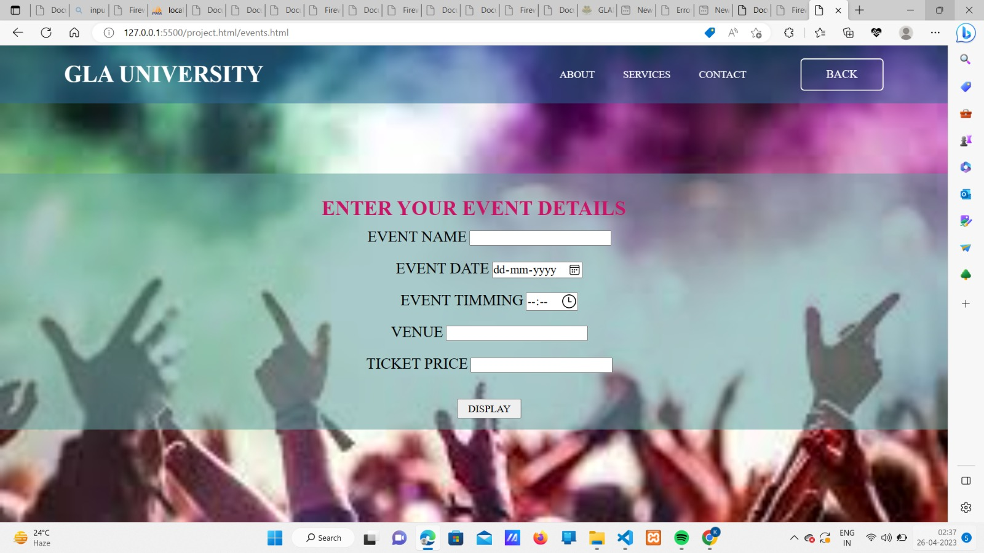

Slide 17
https://github.com/kratika2140/miniproject2
https://github.com/ManyaJain08/miniproject2

Slide 18
THANK YOU

